Slide 1


Salesforce
“Change & Adoption in a Box”
Playbook
April 2019

Slide 2
Purpose of this playbook
Today, many of the Sales Transformation efforts we manage for our clients are enabled by Salesforce. Key to fully operationalizing those transformation efforts is effectively managing the end user adoption of Sales Cloud.
PwC’s People & Organization practice has done this over and over again - for our clients, for the PwC network, and for Salesforce itself. From 2016-2018, we were on the ground at Salesforce managing the internal adoption of Salesforce Lightning Experience and the retirement of Salesforce Classic.
Based on those collective experiences, we’ve put together this playbook to make it easy for you to build a Sales Cloud “Change & Adoption in a Box” solution into your Sales Transformation proposal or engagement. This playbook houses both a roadmap and example deliverables that you can leverage to build a customized change solution for your client.
The intended audience of this playbook are practitioners in the People & Organization, Customer and Salesforce practices, as well as members of Sales and Marketing GTM teams.

Slide 3
Table of contents
1
2
3
High Level Roadmap
Guiding Principles & Best Practices
Planning & Execution
4
5
Sample
Engagement
Models
Change
Enablers

Slide 4

1 – High Level Roadmap
4

Slide 5
High-level roadmap: Salesforce “Change & Adoption in a Box”
This roadmap outlines key activities and deliverables that will allow you to gain leadership support and deliver the enablement activities necessary for end users to take full advantage of the Salesforce platform.
Leadership Comms, End User Comms & Pulse Surveys
Training Needs Assessment
Comms Strategy & Plan
Post Go-Live Assessment
Training Plan & Materials
Vision & Change Strategy
Stakeholder Analysis & Change Impact Assessment
Personas
& Journey Maps
Go-Live Support Plan
Readiness
Communications
Training
Support

Slide 6
Our roadmap is meant to apply to a variety of opportunities
Amid the landscape of Salesforce-enabled engagements, the change management approach laid forth in this playbook is applicable across an array of engagement types:
1
2
3
4
Current State Assessment
Sprint 0 Assessment
New Salesforce Implementation
Migration from Salesforce Classic to Lightning Experience
An assessment that gathers information about existing capabilities to establish a baseline from which an organization can measure transformational change.
Sprint 0 is typically more thorough and includes initial engagement activities like refining the product backlog, architecture envisioning, prioritization, and release planning.
Implementation and integration process to move a new organization to Salesforce, establishing how to perform the basic set-up, engage users, and facilitate adoption.
The process of migrating an organization from Salesforce Classic to Lightning Experience, which requires educating users on UI and functionality that is significantly improved.

Slide 7

2 – Guiding Principles & Best Practices
7

Slide 8

Our guiding principles for Salesforce “Change & Adoption in a Box”
Lean on leadership
Lean on leaders for the change, and ask them to drive action!
Remain Agile
Establish a plan, but adjust based on feedback and issues.
Focus on personas
Segment your population and give them what they need to thrive!
Focus on data
Use adoption metrics and dashboards to determine which groups to move.
Use Salesforce
Leverage the platform’s tools - such as Chatter - to share messages with users!

Slide 9
Best practices for achieving success
Involve the right partners and maintain strong cross-functional relationships: the insight, involvement and support of senior leaders and technical / PMO partners is critical to developing a change strategy that will resonate with end users.
Allow leaders to lean in from the start: set expectations around leadership involvement early in the process, and allow them the ability to provide suggestions and review communications and training deliverables on a continual basis.
Focus on relationships
Identify, track and publicize metrics: define adoption metrics and user stories and incorporate them into your leadership readouts; this will increase buy in and advocacy for the use of Salesforce.
Utilize go / no go dates heavily: establishing go / no go meetings early and mandating attendance by business leadership, PMO and technical partners is key to setting expectations and gaining commitment to move forward with rollout phases.
Maintain transition plans: as team members roll on and off the project, maintain an updated onboarding guide and transition plan to make for smoother movement of resources.
Set program standards
Understand the organization’s tone and culture: work to understand the tone, cultural elements and channels that will make users more receptive to your messaging, and leverage that for standard and tailored communications.
Distribute with leadership support: encouragement from leaders is sometimes required to generate higher traffic, and managers (in addition to leadership) should be proactive in asking their team members to actively participate in training.
Provide support: establish guidelines for the way in which users should seek support (change champions, Chatter groups, etc.) and make those support channels known through communications.
Tailor the approach
Course correct along the way
Be willing to pilot: piloting planned change activities with smaller groups will allow you to incorporate feedback and course correct for more effective product adoption across your main user groups.
Listen and gather feedback: take the time needed to understand your stakeholder groups and their needs, and engage a diverse set of SMEs to consolidate, analyze and address feedback.

Slide 10
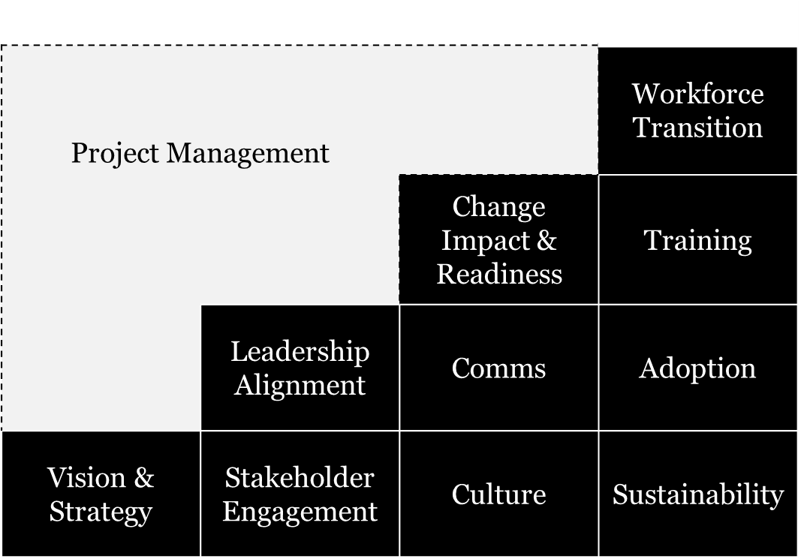
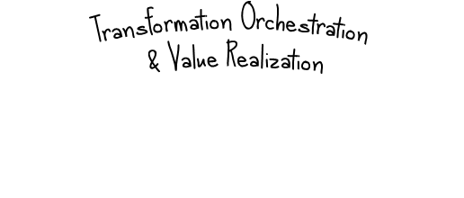

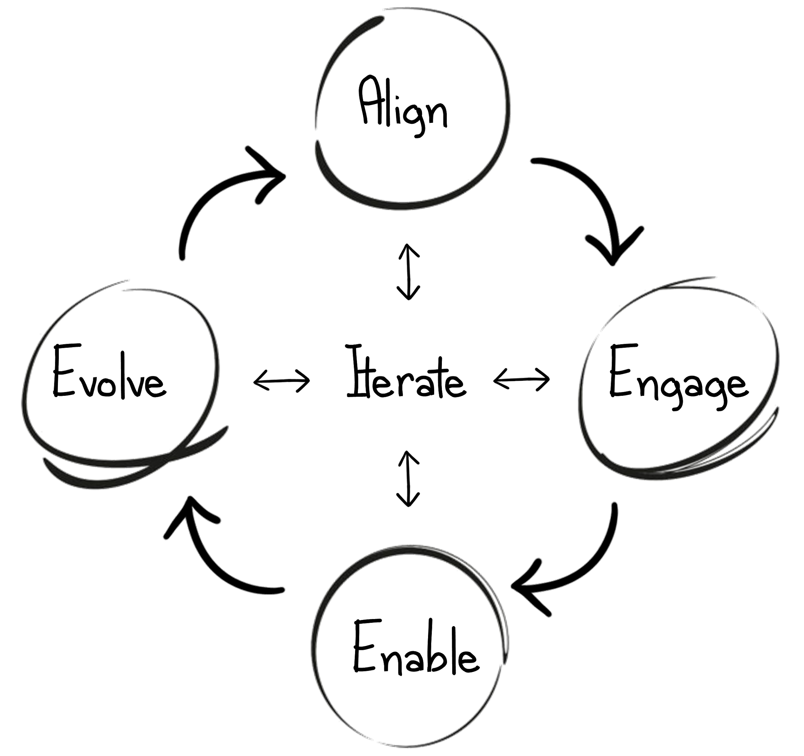
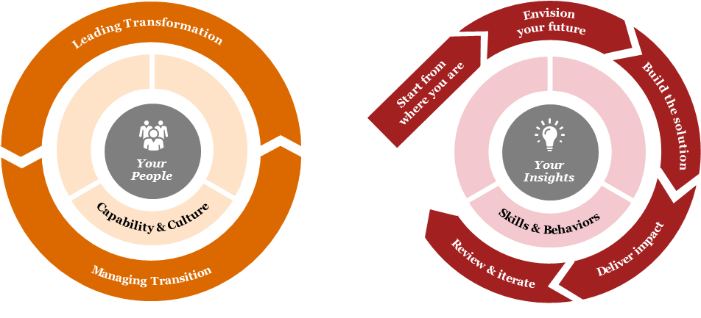


And remember that there are different ways to approach change...
Click the links to learn more about each approach!
PwC has continued to evolve it’s view on change, and has developed a handful of its approaches that are useful in thinking through how to support your client
Building Blocks
People Centric Change Approach
nxtgenChange
Effective Change Management strategies and approaches take into consideration the 10 critical building blocks of change. It is important to address each building block through the dimensions of people, process, and technology.
Research and experience tells us organizations that put their people at the heart of change are more likely to deliver successful outcomes. It is increasingly important to run their business in a way that accounts for wider stakeholder expectations.
nxtgenChange is a People-Centric Transformation approach that advocates for treating change as a movement. It helps generate desired business outcomes by rallying the right people and equipping them and their environment to realize value.

Slide 11

3 – Planning & Execution
11

Slide 12
Key deliverables by stage and focus area
Strategy & Assess
Design
Construct
Implement
Operate, Review & Sustain
Start from where you are
Envision your future
Build the solution
Deliver impact
Review & iterate
Readiness
Change Strategy Vision Document Stakeholder Analysis Org. Impact Assessment Personas | Journey Maps Change Plan Change Agent Network Roles & Responsibilities | Change Readiness Assessment | Go-Live Assessment
Comms Strategy | Comms Plan | Leadership Comms End User Comms: Ready / Set / Go | Pulse Surveys
Training Needs Assessment Training Strategy | Training Plan | Instructor-Led Training Micro Videos Quick Reference Guides Job Aids Training Hubs / Sites Gamification | Train-the-Trainer
Adoption Metrics |  |  | Go-Live Support Plan | Post Go-Live Assessment Lessons Learned
Communications
Continuation of Outstanding Activities
Training
Support

Slide 13
Library of materials
The Salesforce “Change & Adoption in a Box” Toolkit G-drive houses everything you need to plan for and execute a Salesforce Transformation project. The contents of this folder include sample deliverables across the categories described below. Please note that examples come from both Salesforce Rollout projects and Lightning Adoption projects.
Proposal Resources
Communications
Support
Salesforce Rollout Change Mgmt.
Communications Strategy
Adoption Metrics
Lightning Adoption Change Mgmt.
Communications Plan
Go-Live Support Plan
PwC Salesforce Adoption Journey
Leadership Communications
Post Go-Live Assessment
End User Communications
Lessons Learned
Readiness
Pulse Surveys
Change Strategy
Training
Vision Document
Stakeholder Analysis
Training Needs Assessment
Impact Assessment
Training Strategy
Personas & Journey Maps
Training Plan
Change Plan
Instructor-Led Training
Change Agent Network
Micro Videos
Roles & Responsibilities
Quick Reference Guides
Change Readiness Assessment
Job Aids
Go-Live Assessment
Training Hubs / Sites
Adoption Metrics
Gamification
Adoption Metrics
Train-the-Trainer

Slide 14
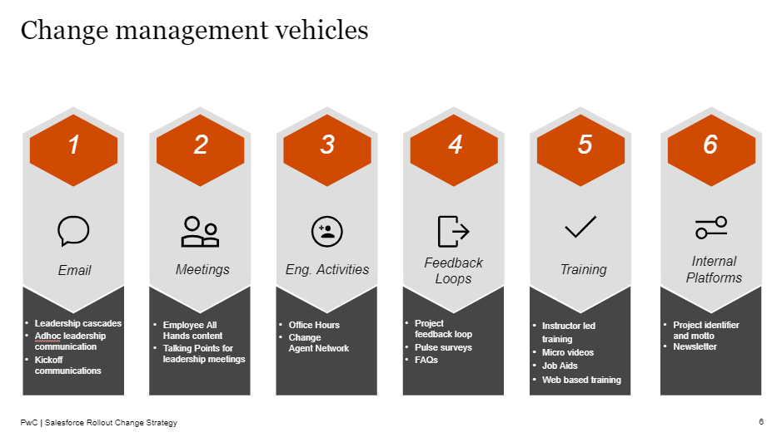
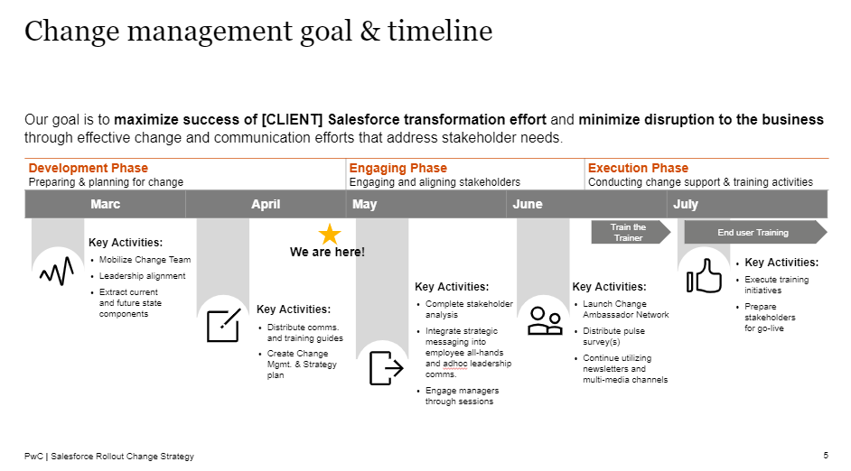
Change Strategy: establish the foundational scope and objectives
Change Strategy
Readiness
Description:
The Change Strategy establishes a foundation for the management of a change workstream during a transformation project. The change strategy outlines the goals, tools, support mechanisms, plans and metrics necessary to support all stakeholders and users impacted over the course of the engagement.
Purpose & Value:
This deliverable adds value by defining the scope, aligning key expectations and creating a powerful foundation for later work to be built on.
Material(s):
EX - Change Strategy

Slide 15
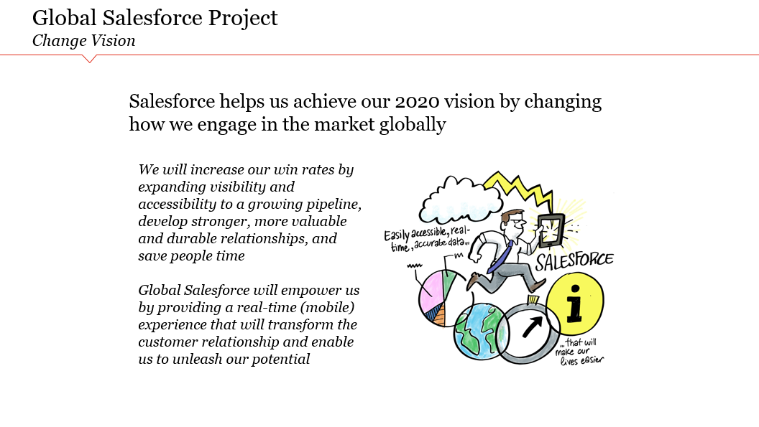
Vision Document: craft a compelling story to guide the project
Vision Document
Readiness
Description:
The Vision Document provides an overarching story about why the initiative is being undertaken, why it is important and what the desired outcomes and benefits are. It can be represented in words or visually.
Purpose & Value:
This deliverable adds value by creating a consistent story that can be communicated throughout the change life cycle. It generates shared understanding, guidance, commitment and enthusiasm for the change within the organization.
Material(s):
EX - Vision Document

Slide 16
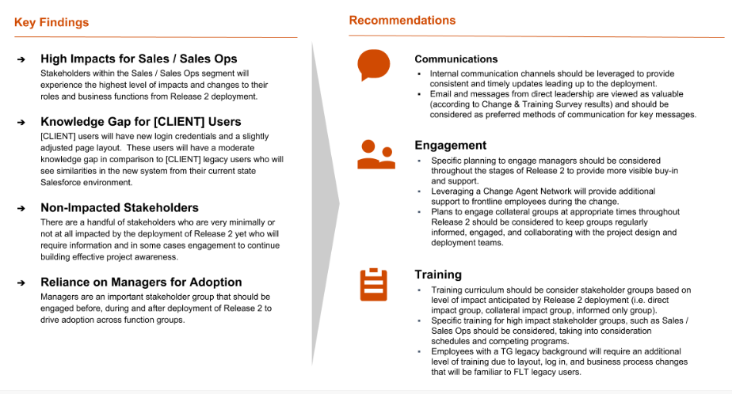
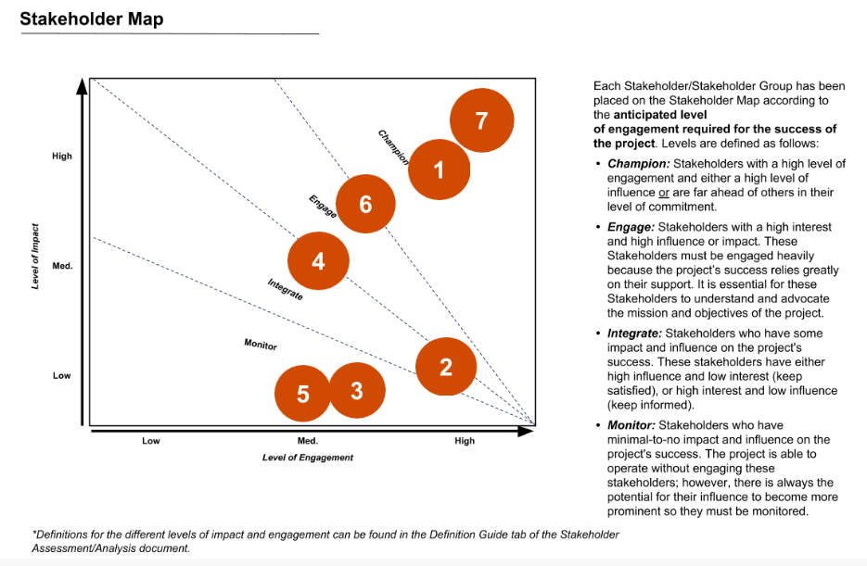
Stakeholder Analysis: map out stakeholder interaction and engagement
Stakeholder Analysis
Readiness
Description:
The Stakeholder Analysis is a tool that identifies and sizes the stakeholders who are impacted by the project, and also defines the needs and assesses the impact on each group.
Purpose & Value:
This deliverable provides key information which can be used to create a stakeholder map, which measures the level of impact and engagement for each stakeholder group. This map assesses how to engage with each group over the course of the project, and may provide initial thoughts on communications, training and support needs.
Material(s):
EX - Stakeholder Analysis

Slide 17
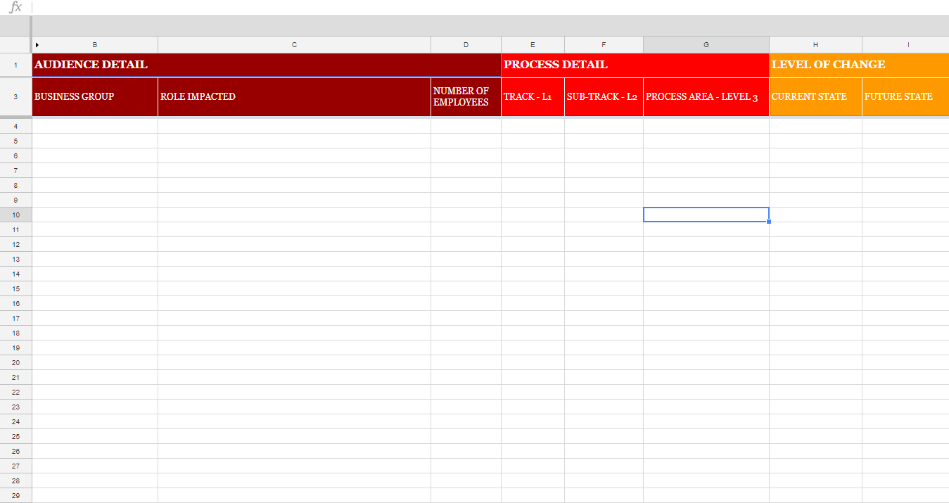
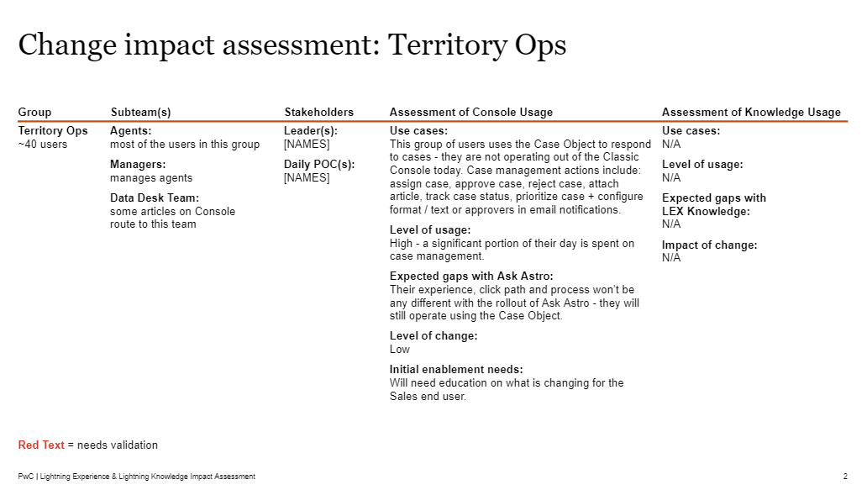
Impact Assessment: identify critical change implications
Impact Assessment
Readiness
Description:
The Organization Impact Assessment provides an organizational view of the changes that a Salesforce transformation will bring to an organization. The impacts are presented in a number of contexts, such as organization-wide shifts, department / business unit shifts, and changes in process between the current and future state.
Purpose & Value:
This deliverable adds value by helping the change team identify training, communications, and workforce implications that must be addressed to support the key end users as they transition to the future state.
Material(s):
EX - Organization Impact Assessment

Slide 18
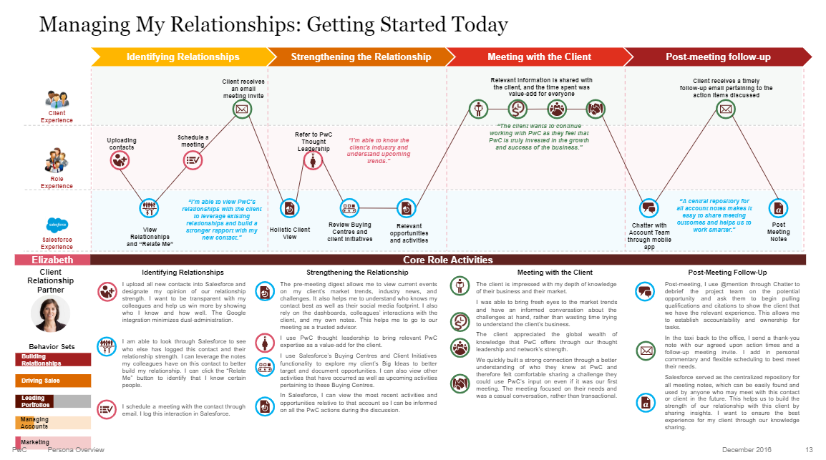
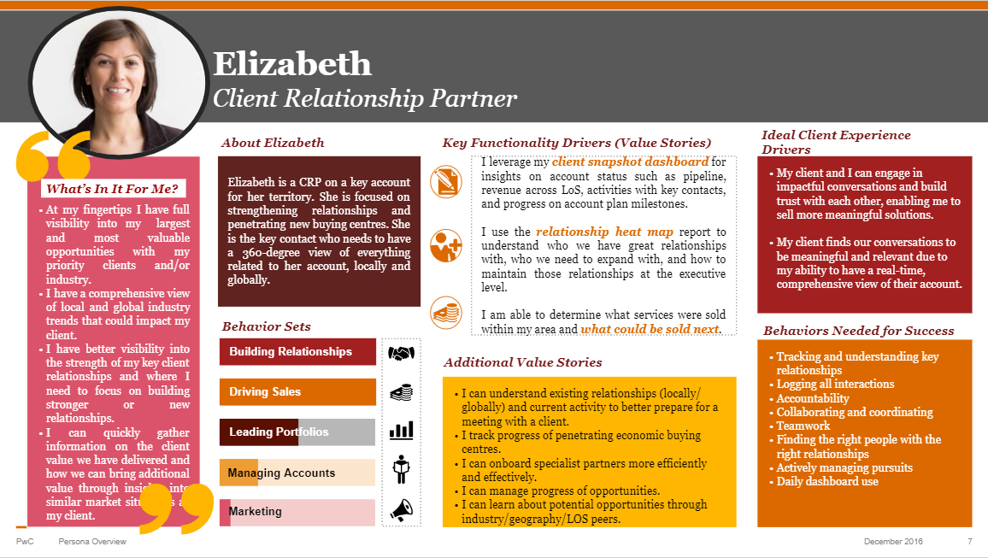
Personas & Journey Maps: capture end-to-end user insights
Personas & Journey Maps
Readiness
Description:
Personas represent the needs, wants, and behaviors of a set of users that interact directly with Salesforce on a day-to-day basis. Journey maps portray the tactical activities that portray how those users would interact with Salesforce and how Salesforce would bring value to their role.
Purpose & Value:
These deliverables add value by illustrating the end-to-end experience of different Salesforce users, revealing key insights that can be embedded into change and adoption efforts, which ultimately help to maximize engagement and adoption.
Material(s):
EX - Personas & Journey Maps

Slide 19
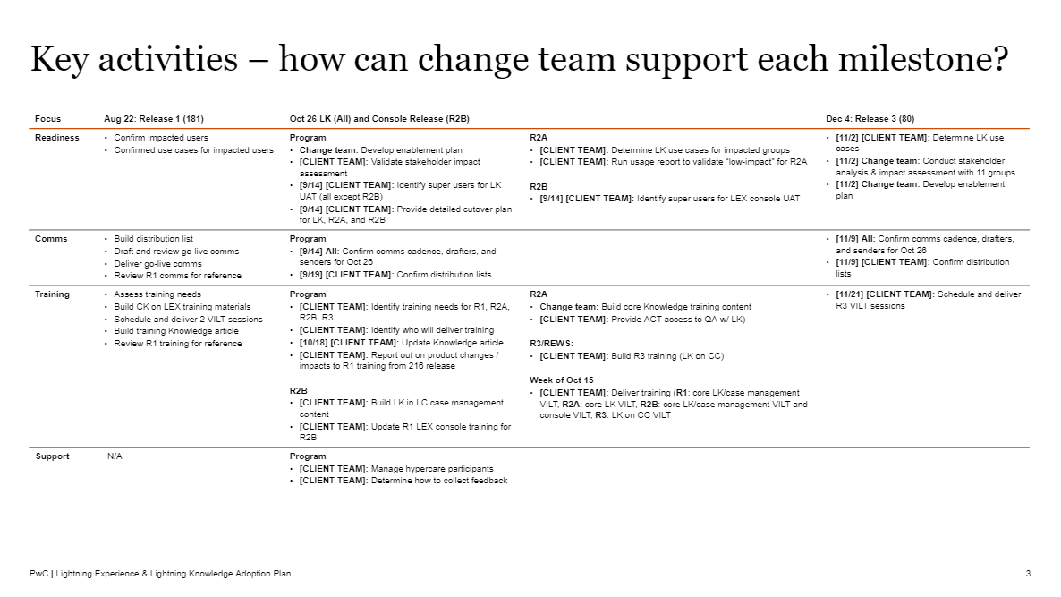
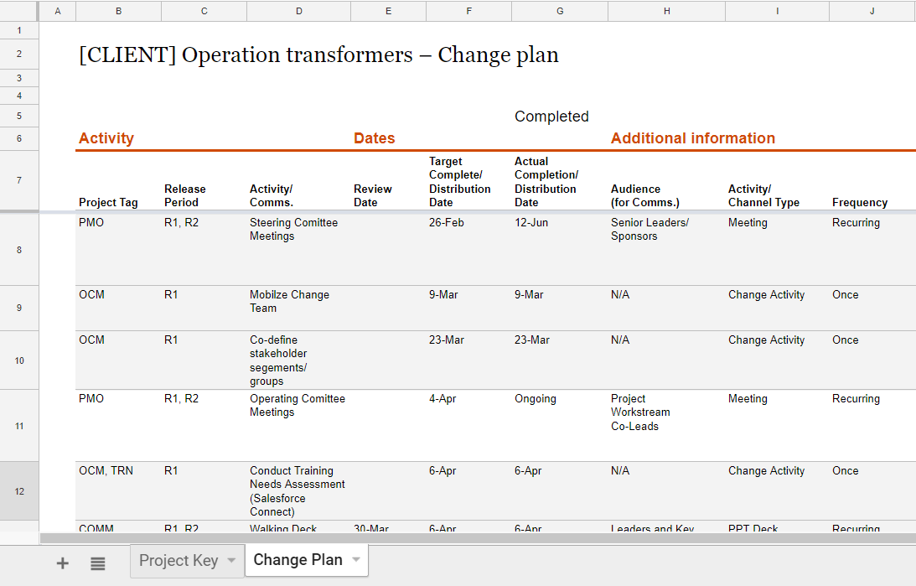
Change Plan: define the key activities required
Change Plan
Readiness
Description:
The Change Plan outlines the key activities that must take place across all project areas, from communications to project management. For each activity, the plan defines key dates, roles and other necessary information.
Purpose & Value:
This deliverable adds value by mapping out specific responsibilities and tasks, by which the project and client team can use to measure progress and success.
Material(s):
EX - Change Plan

Slide 20
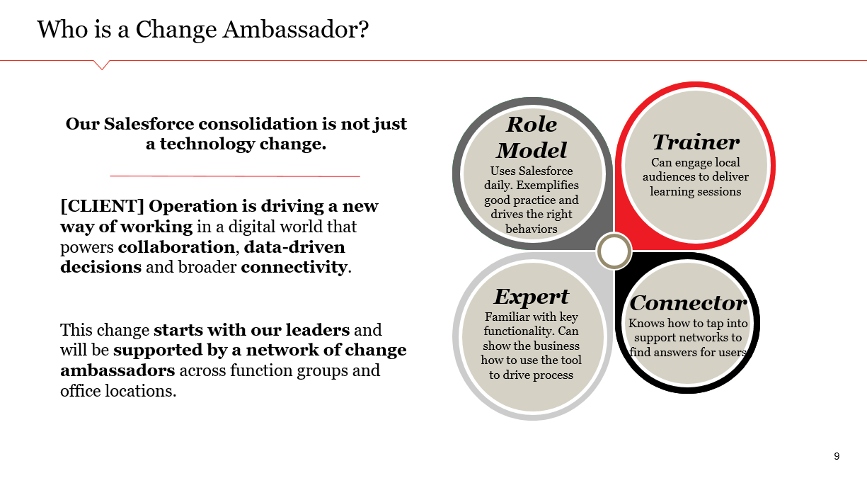
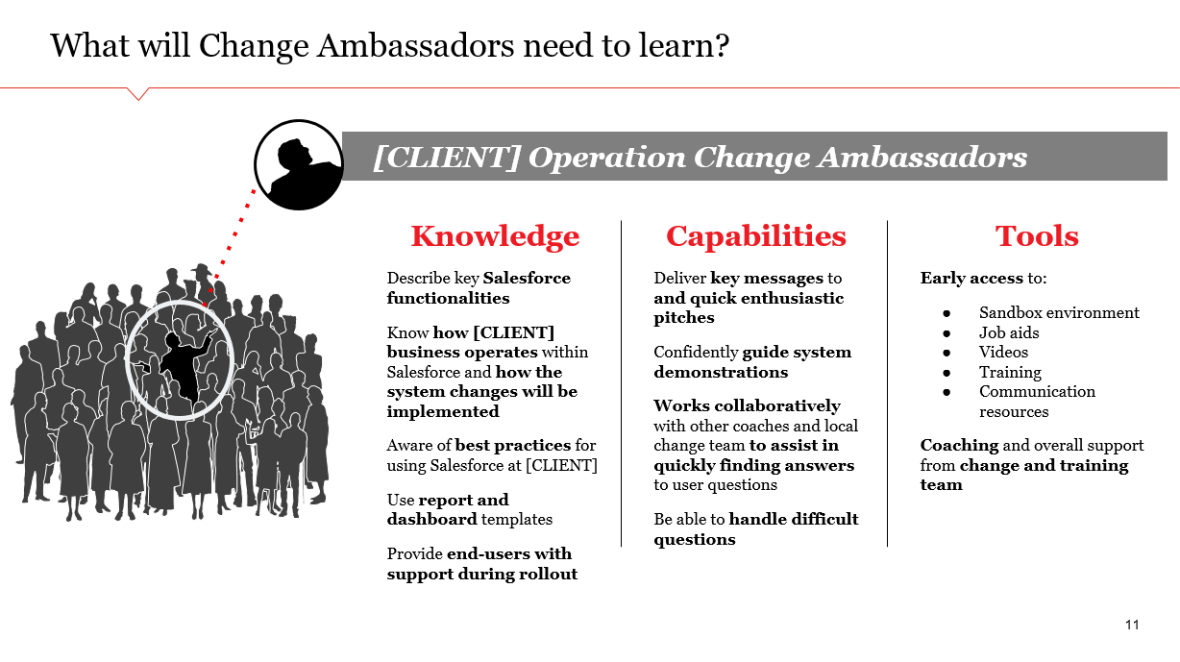
Change Agent Network: activate ambassadors to enable change
Change Agent Network
Readiness
Description:
The Change Agent Network is a cross-functional group of business representative that assist change teams in the implementation of change initiatives.
The strategy for a Change Agent Network outlines the structure, tools, strategies and engagement needs of the network.
Purpose & Value:
The Change Agent Network strategy designates the key activities necessary to identify, activate and manage the network over the course of the project. As “champions” for change, Change Agents are key influencers who tell the change story and reiterate the importance of change to their team members.
Material(s):
EX - Change Agent Network

Slide 21
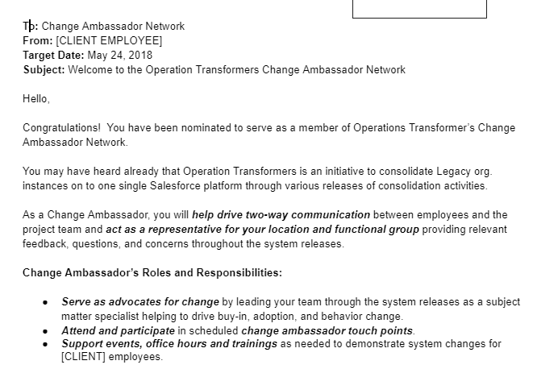
Roles & Responsibilities: set key expectations for the Change Agents
Roles & Responsibilities
Readiness
Description:
Roles & Responsibilities documents define the specific roles that Change Agents play in advancing change initiatives to key groups during the transformation. Roles range from being an advisor to the change team to being the point-of-contact in a specific market. Each role is linked to specific responsibilities.
Purpose & Value:
This deliverable adds value by ensuring stakeholder support and championship across all phases of the project, from planning to implementation. It also sets specific and measurable expectations for Change Agents to fulfill their roles.
Material(s):
EX - Roles & Responsibilities

Slide 22
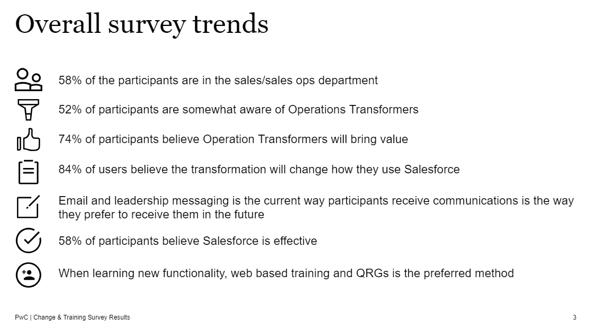
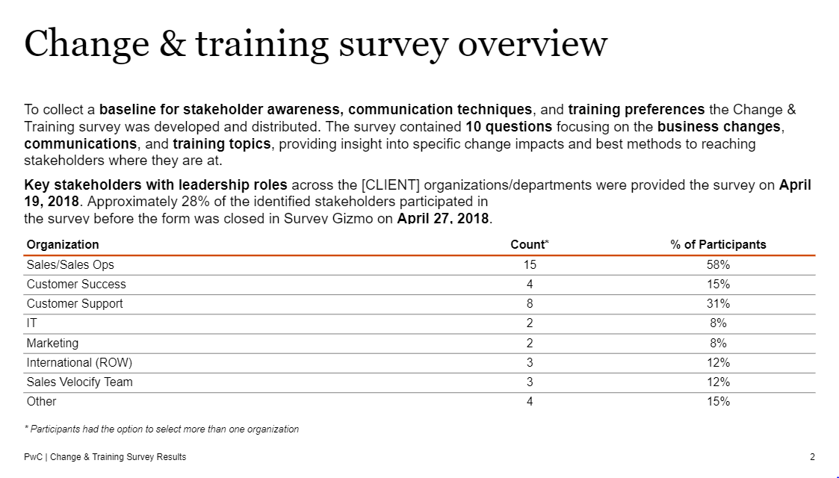
Change Readiness Assessment: create a baseline for change
Change Readiness Assessment
Readiness
Description:
The Change Readiness Assessment uses various techniques like stakeholder and end user surveys to collect key information about readiness before key phases of the project. Topics to measure include businesses changes, communications needs and training needs.
Purpose & Value:
This deliverable provides valuable insights that help create a baseline for end user awareness, communication techniques and training preferences.
Material(s):
EX - Change Readiness Assessment

Slide 23
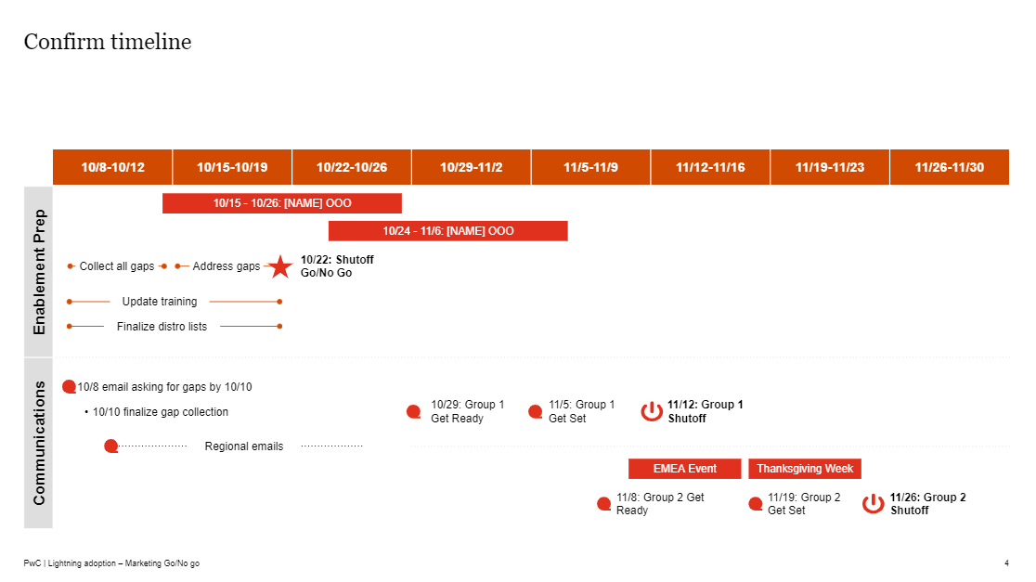
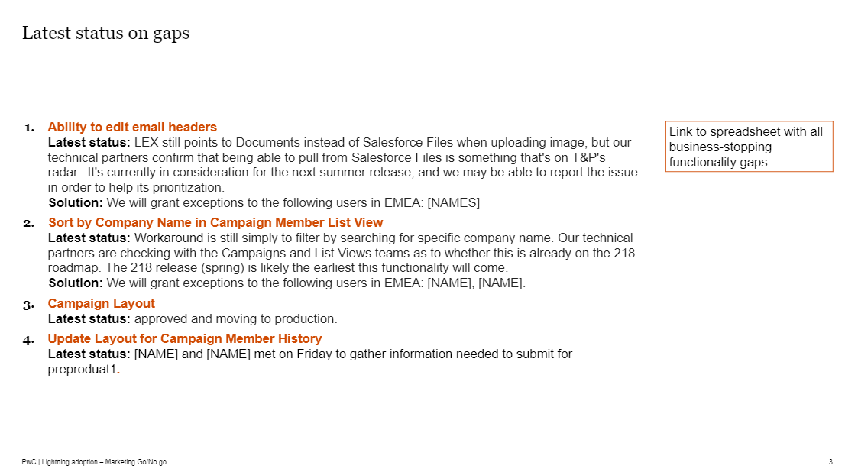
Go-Live Assessment: reach a final “go / no go” decision
Go-Live Assessment
Readiness
Description:
The Go-Live Assessment includes key status updates on change workstreams and confirms the timeline, distribution list, communications and next-steps prior to the go-live date.
Purpose & Value:
This deliverable adds value by aligning the project team and key stakeholders on the status of all key change activities prior to go-live. It enables the change team to make the final go / no-go decision.
Material(s):
EX - Go-Live Assessment

Slide 24
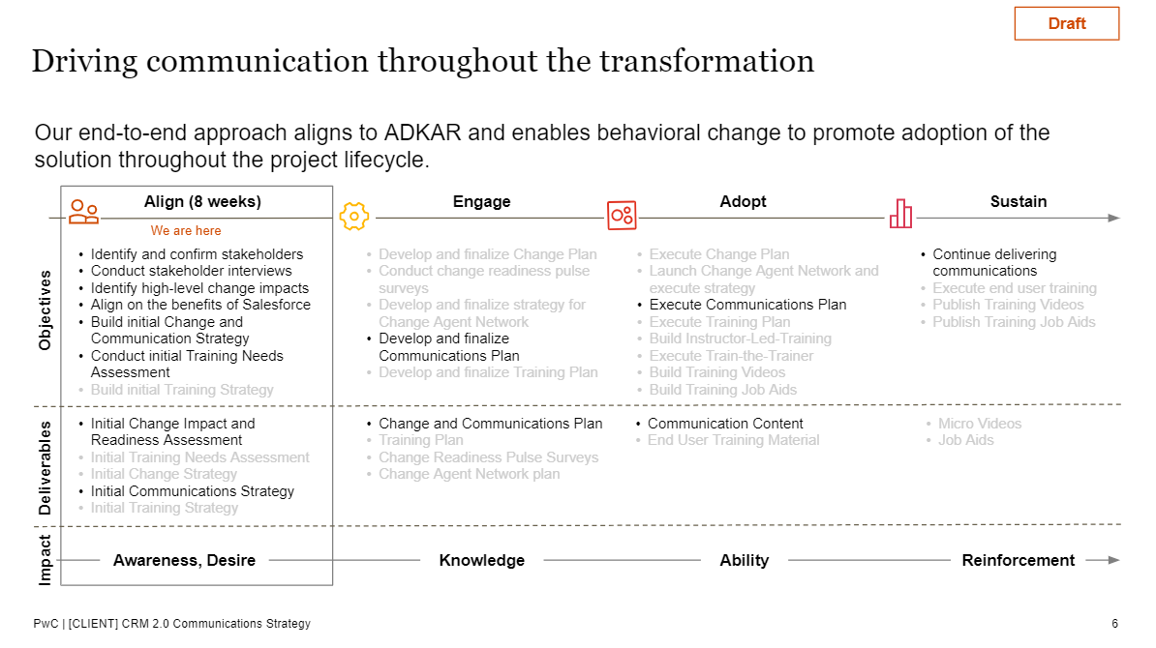
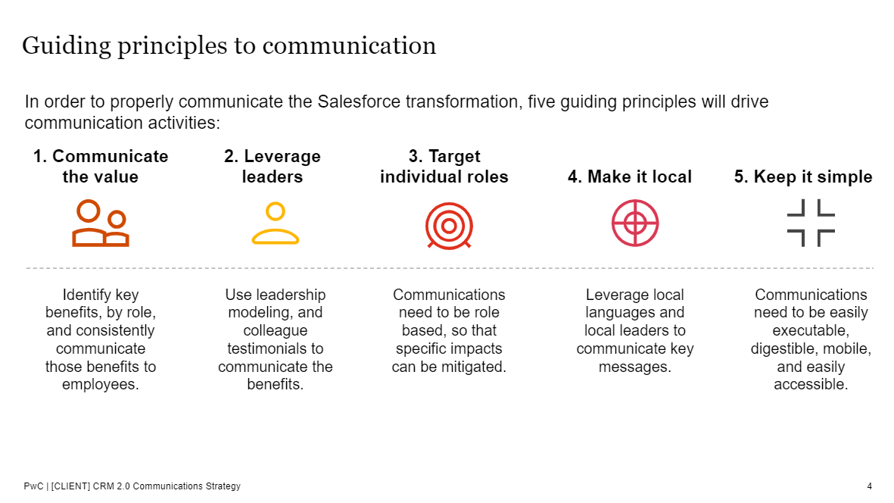
Communication Strategy: define the overall communications approach
Communications Strategy
Communications
Description:
The Communications Strategy defines the overall approach to communications and stakeholder management for the change initiative. It also specifies the objectives, best practices, key messages, communications channels, and more.
Purpose & Value:
This deliverable adds value by framing the entire communications effort, which will enable organizational support and educate users on the change and how it impacts them.
Material(s):
EX - Communications Strategy

Slide 25
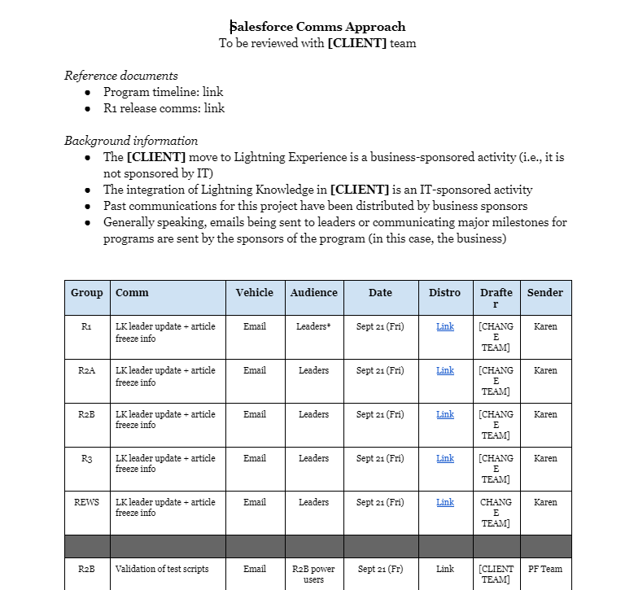
Communications Plan: create an inventory of communication actions
Communications Plan
Communications
Description:
The Communications Plan documents an inventory of communication items needed to meet the key communications objectives. For each item, important details are included, such as the audience, send date, owner, core message, frequency and communication vehicle.
Purpose & Value:
This deliverable adds value by allowing the change team to track progress and ensure accountability. The execution of the Communications Plan will ultimately help the organization gain commitment to and adoption of change.
Material(s): EX - Communications Plan

